Slide 1








HACKATHON PROJECT TITLE
YOUR CRYPTO
TRIAL BLAZZERS
ANANYA S ANGADI NAFISA .N
Organized under Agamya Tech Summit2025|ManagedbyIEEEComputerSociety–KLEIT | In Partnership with CySeck

Slide 2
PROBLEM STATEMENT
• New ornontechinicalueserswhowant
to use cryptocurrencies
• enables secure simple and accessible
cryptotransactions
• Existing wallets are often complex confusing or intimidating for newbies
Organized under Agamya Tech Summit 2025 | Managed by IEEE Computer Society – KLEIT | In Partnership with CySeck

Slide 3
PROPOSED SOLUTION
Short descriptionofthe solution: Abeginner-friendlycrypto wallet that simplifies sending, receiving, and tracking transactions. Key features / innovations: Simple GUI, transaction history, balance display, and optional QR code for easy transfers. Why is it better than alternatives: Reduces complexity and risk, making crypto accessible and safe for non-technical users.
Organized under Agamya Tech Summit 2025 | Managed by IEEE Computer Society – KLEIT | In Partnership with CySeck

Slide 4
FEATURES & TECHNOLOGY
Features: •send •receive •track transactions
Organized under Agamya Tech Summit 2025 | Managed by IEEE Computer Society – KLEIT | In Partnership with CySeck

Slide 5
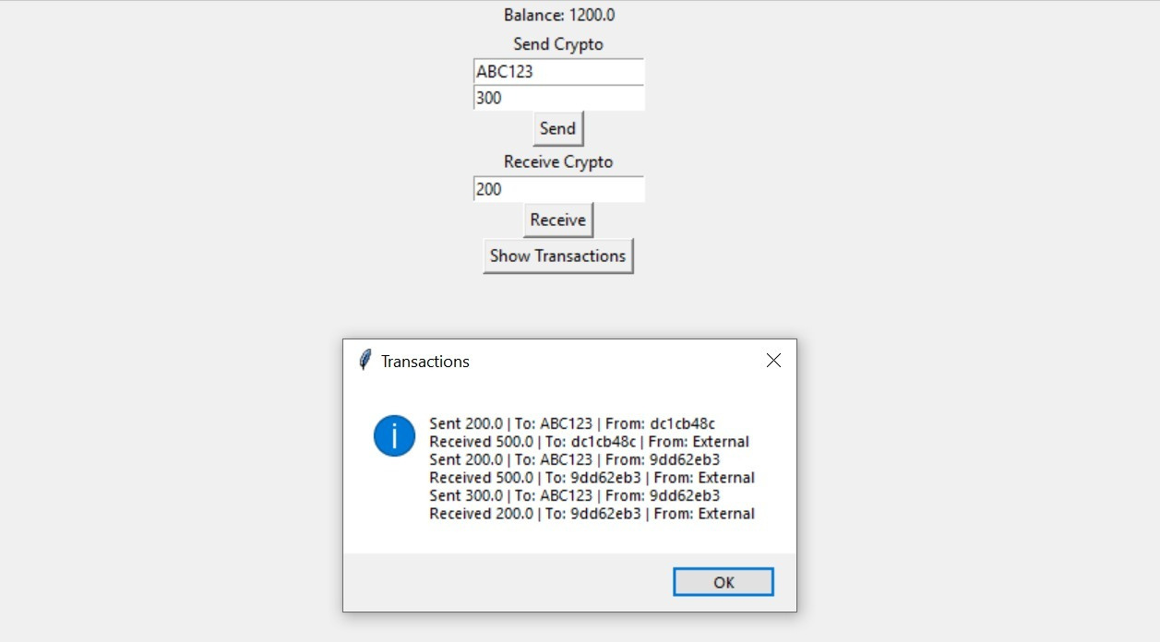
DEMO / PROTOTYPE
Organized under Agamya Tech Summit 2025 | Managed by IEEE Computer Society – KLEIT | In Partnership with CySeck

Slide 6
IMPACT & FUTURE SCOPE
Who benefits:Beginnersandnon-technical crypto users.
Short-term & long-term impact: Immediate ease of use and long- term adoption of secure crypto practices. Roadmap / scaling ideas: Add multi-currency support, mobile app, real blockchain integration, and enhanced security features.
Organized under Agamya Tech Summit 2025 | Managed by IEEE Computer Society – KLEIT | In Partnership with CySeck

Slide 7

THANK YOU
Organized under Agamya Tech Summit 2025 | Managed by IEEE Computer Society – KLEIT | In Partnership with CySeck

